Slide 1
QuikEvaq
Evacuation Assistance App

Slide 2
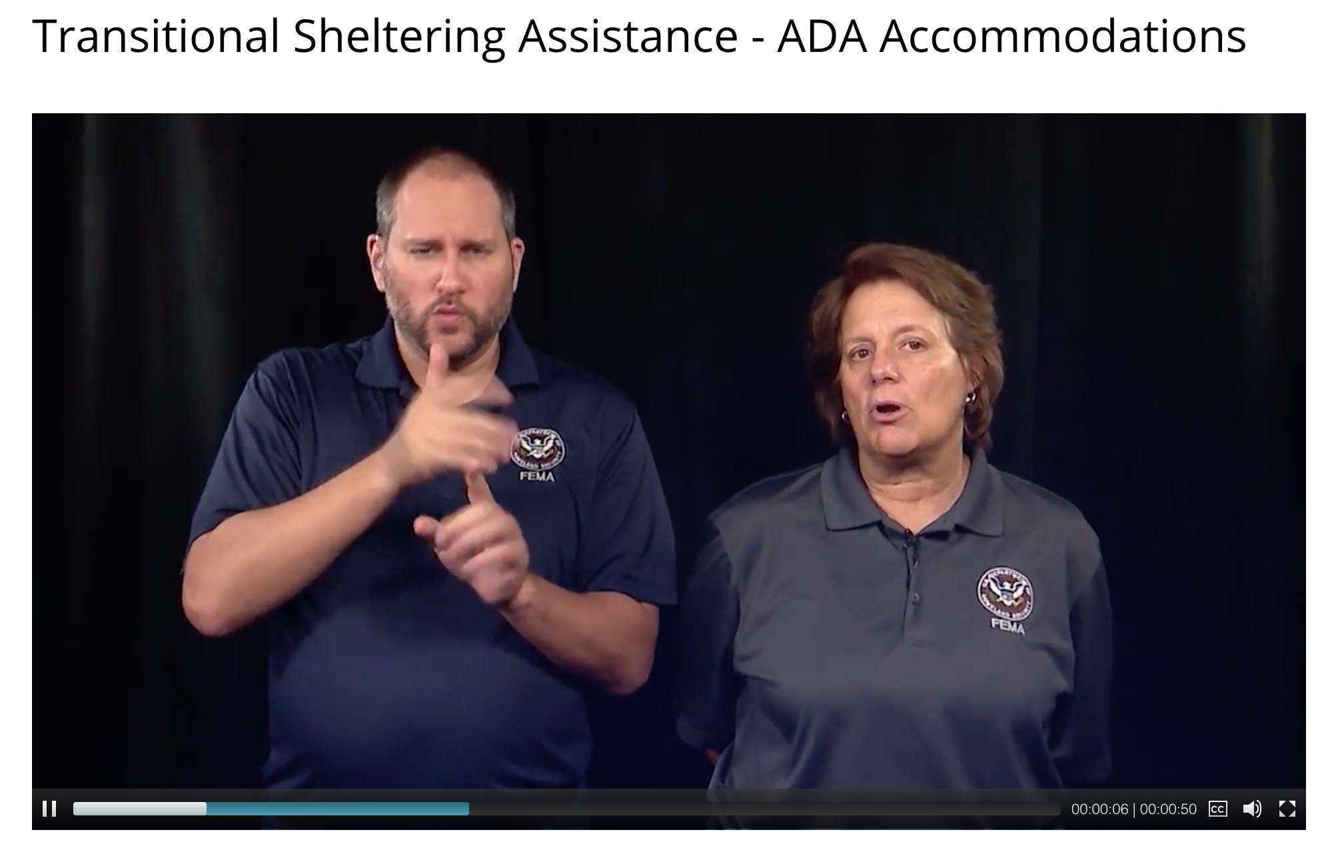
Social Impact
Problem: In the event of a natural disaster, people with disabilities are unaware if shelters are ADA compliant.
It is very easy to lose track of our loved ones during national disasters.
Some people with disabilities are unable to evacuate during national disasters due to lack of mobility and no caregiver/family.
To find out if a shelter has accessibility like Hotels and Motels, persons would have to call beforehand or show up and ask, which makes it very troubling if those locations don’t have services for them or have easy contact before they arrive.

Slide 3

Solution
Create an app that is inclusive to differently-abled persons in case of an emergency.
Allows differently-abled persons to find locations and resources that include them in case of a disaster.
It is ADA compliant.

Slide 4
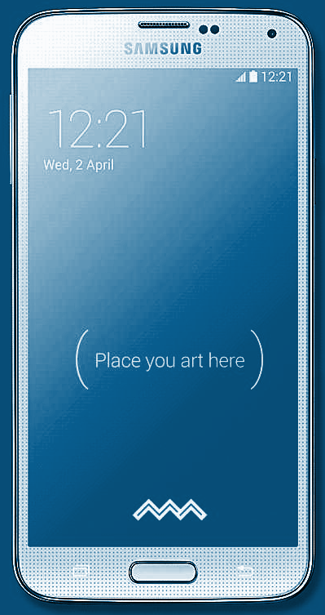
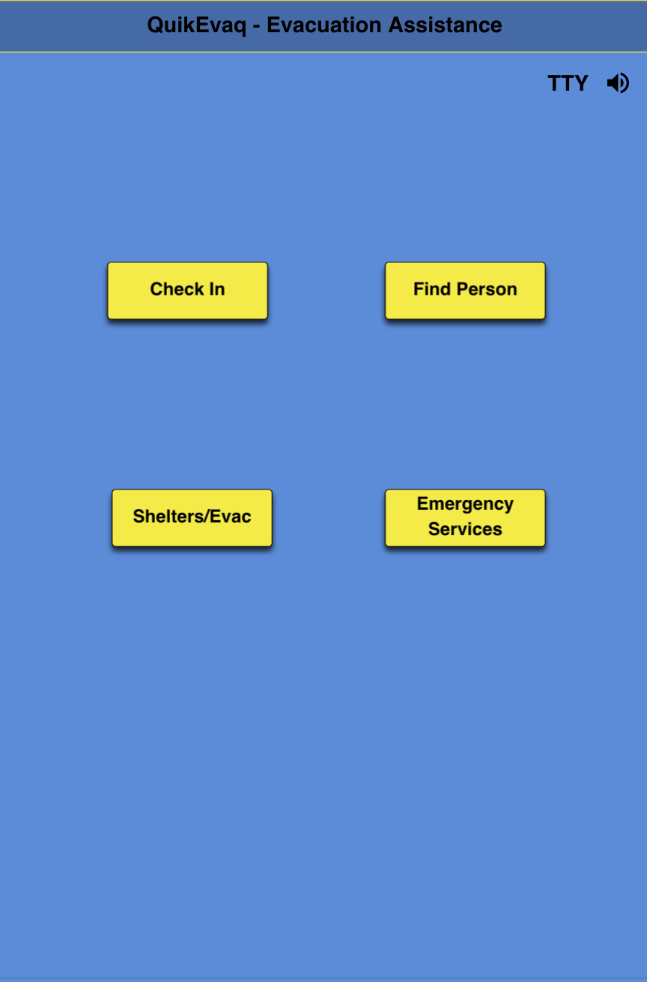
Design
Main Menu Options:
Check In
Find Person
Shelters/Evacuation
Emergency Services

Slide 5
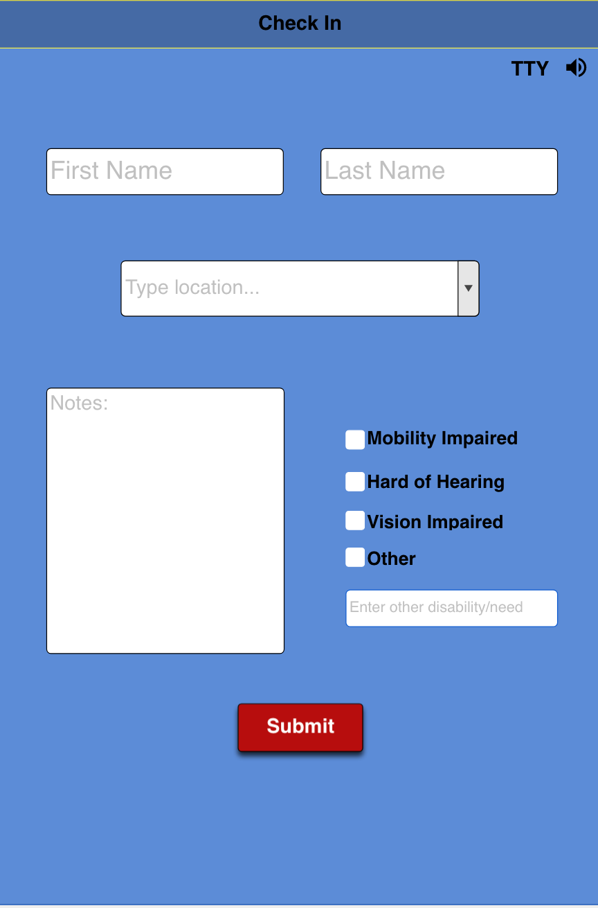
Check-In
Feature that allows users to log information on their current or most recent location to be located.
Input important information that could be helpful to be found.

Slide 6
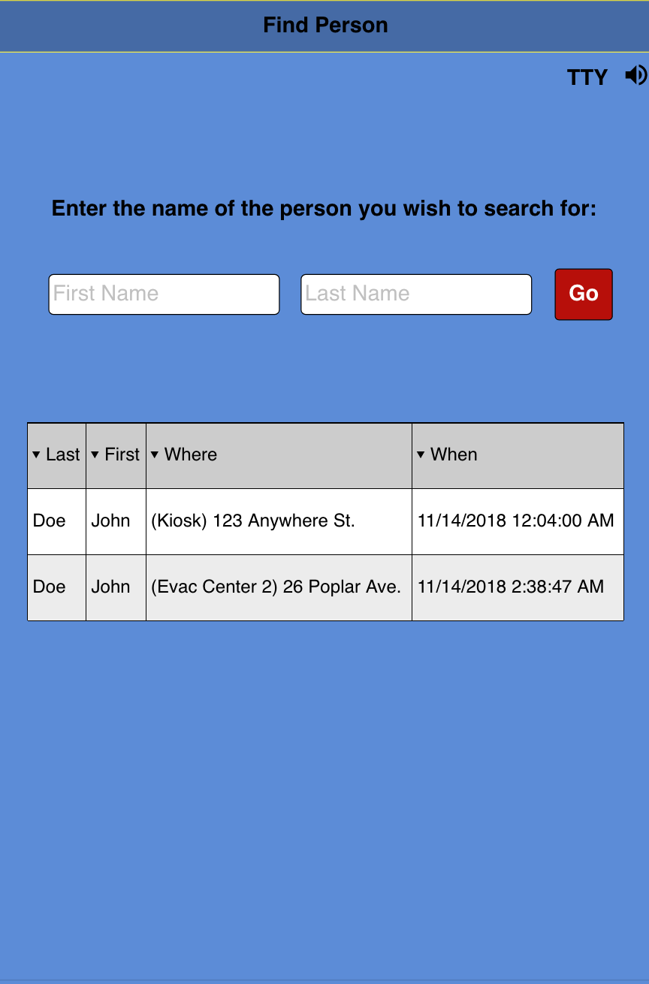
Person Finder
Locates other loved ones in case of an emergency or everyday necessity.
Government agencies would be able to look up any missing persons during a disaster.

Slide 7
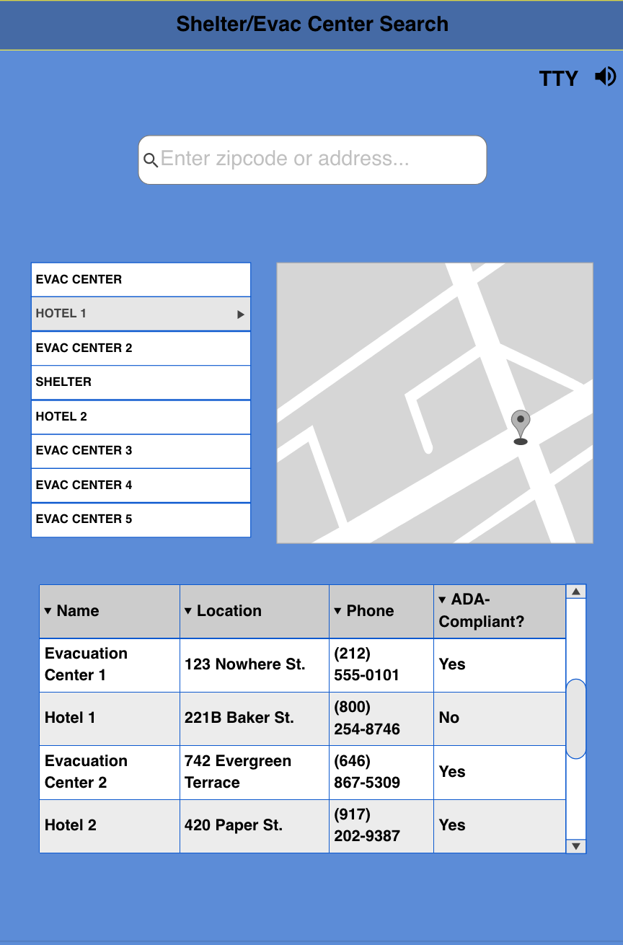
Map and Shelter/Evacuation Centers
Shows nearby shelters, evacuation centers, or hotels and how to reach them
Contact information
Shows whether the location is ADA compliant

Slide 8
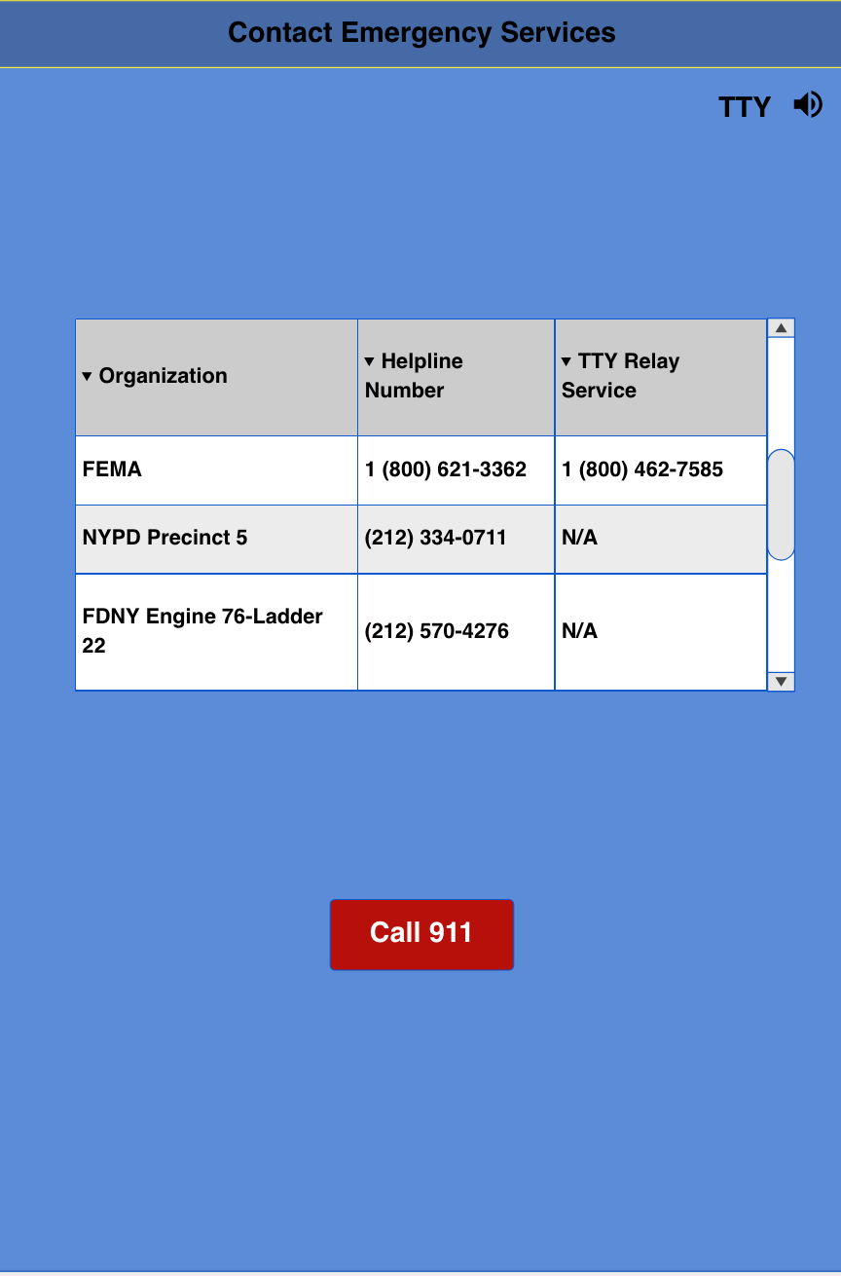
Emergency
Local Agencies
National Hotlines/ Helplines

Slide 9
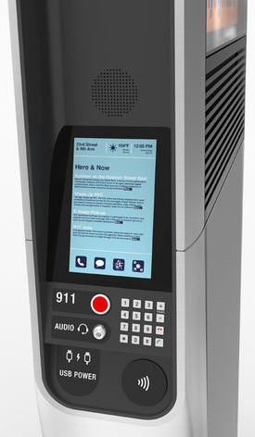
Sustainability
Kiosk availability in centers and outside locations(Link NYC).
Not only useful for disasters, also useful for everyday search.
Check-in could help locate persons in any situation, especially if they are not abled-body.
Partner with other government agencies.

Slide 10
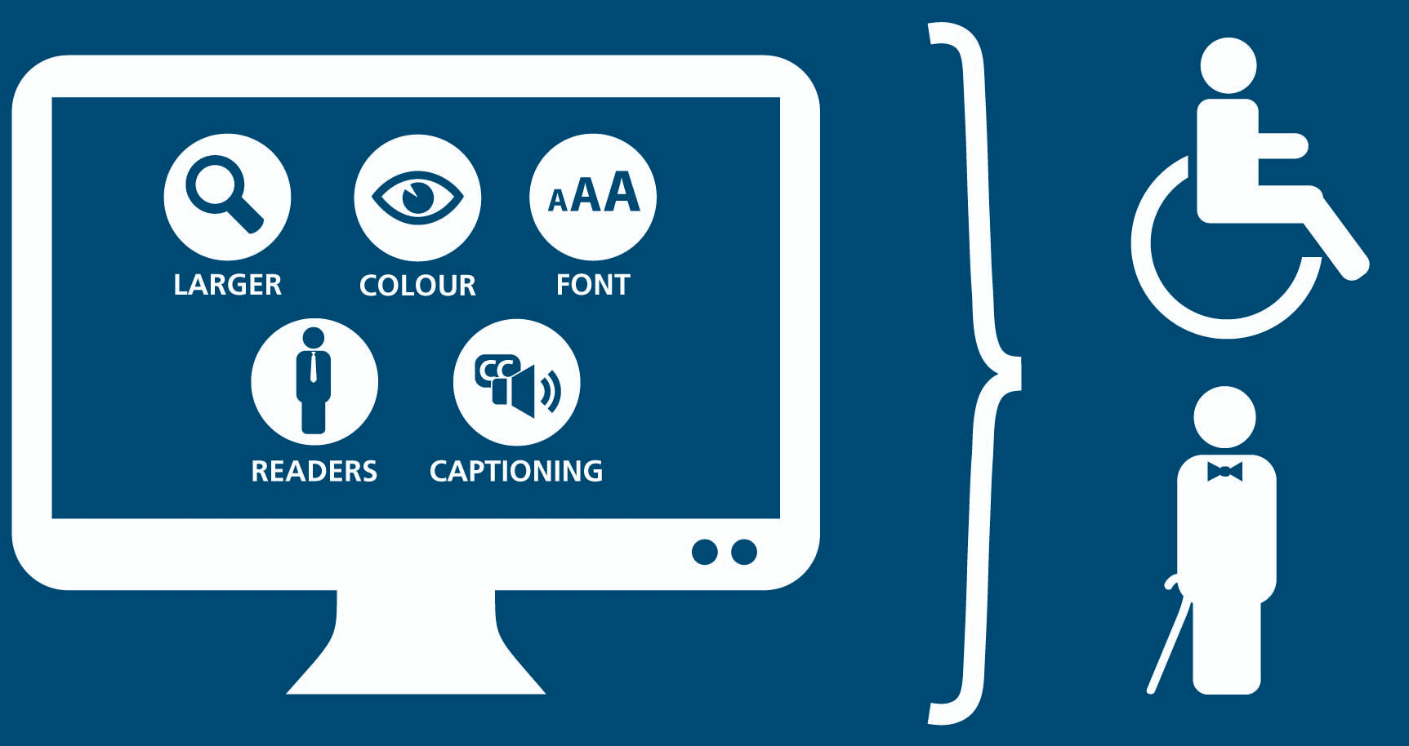
Innovation & Creativity
Although there are apps that have similar functions to ours, our app is more inclusive and versatile outside of disasters.
Some information would be pre-downloaded in case of loss of network connection.
Disaster response apps do not tend to be ADA compliant or cater to different-abled persons:
Uses visually-impaired friendly format
Hard of Hearing TTY descriptions
Wheelchair accessibility
Other types of accessibility

Slide 11





Tech Stack
Languages: Java, XML
Tools/Frameworks: Android Studio
Datasets: NYC Open Data

Slide 12
Next Steps...
LinkNYC integration.
ArcGIS implementation to track open shelters in real time.
UI/UX improvements
Connect and/or share to social media (Facebook “Check In”) for easy access and profile syncing.
Picture/Video Recording
Expand to outside New York City area

Slide 13
Participants
Luanna, Lucero, Xiomara, Alina

